Slide 1
Chapter 28:
Direct Current (DC) circuits
Reading assignment: Chapter 28
Homework 28.1, due Friday, March 22: OQ6, OQ8, OQ9, OQ10, 1, 2, 5, 7, 9, 11, 19, 21
Homework 28.2, due Monday, March 25: OQ12, OQ14, OQ15, 23, 24, 33
Homework 28.3, due Wednesday, March 27: OQ7, 38, 39, 46
Analysis of electric circuits that contain batteries, resistors and capacitors
Electromotive force (max. voltage output of battery, not a force)
Resistors in series and parallel (also review capacitors in series and parallel)
Kirchhoff’s rules
RC circuits, time constant of RC circuits
Household wiring, breakers
Midterm 2: Monday, April 1, in-class
Material: Chapters 25 (Homework 25.3) through Chapter 28
Review: Sunday, March 31, 4:00 pm – 6:00 pm

Slide 2
Direct current (DC) and Alternating current (AC)
I₀
Current
Current
Time
Time
-I₀
When a battery is connected to a circuit, the current flows steadily in one direction. This is called direct current or DC. (In resistor/capacitor circuits, current increases/decays over time, but still only flows in one direction).
Electric generators at power plants produce alternating current or AC. That is what comes out of an outlet. Chapter 33 covers AC circuits. Most of the Americas: 110 V – 120V, 60 Hz; rest of the world, 220V – 240V, 50 Hz

Slide 3
Resistors in series
(Two devices are connected in series if they are connected at one end, and nothing else is connected there)
ΔV₁
ΔV₂
ΔV₃
ΔV_{rise}
ΔV_{total} = ΔV₁ + ΔV₂ + ΔV₃
= IR₁ + IR₂ + IR₃
= I(R₁ + R₂ + R₃)
= IR_{eq}
Same current flows through all devices (resistors); if one device breaks, current flow to all is interrupted.
Different voltage drops across devices.
The potential rise at battery is equal to the sum of all potential drops across devices.

Slide 4
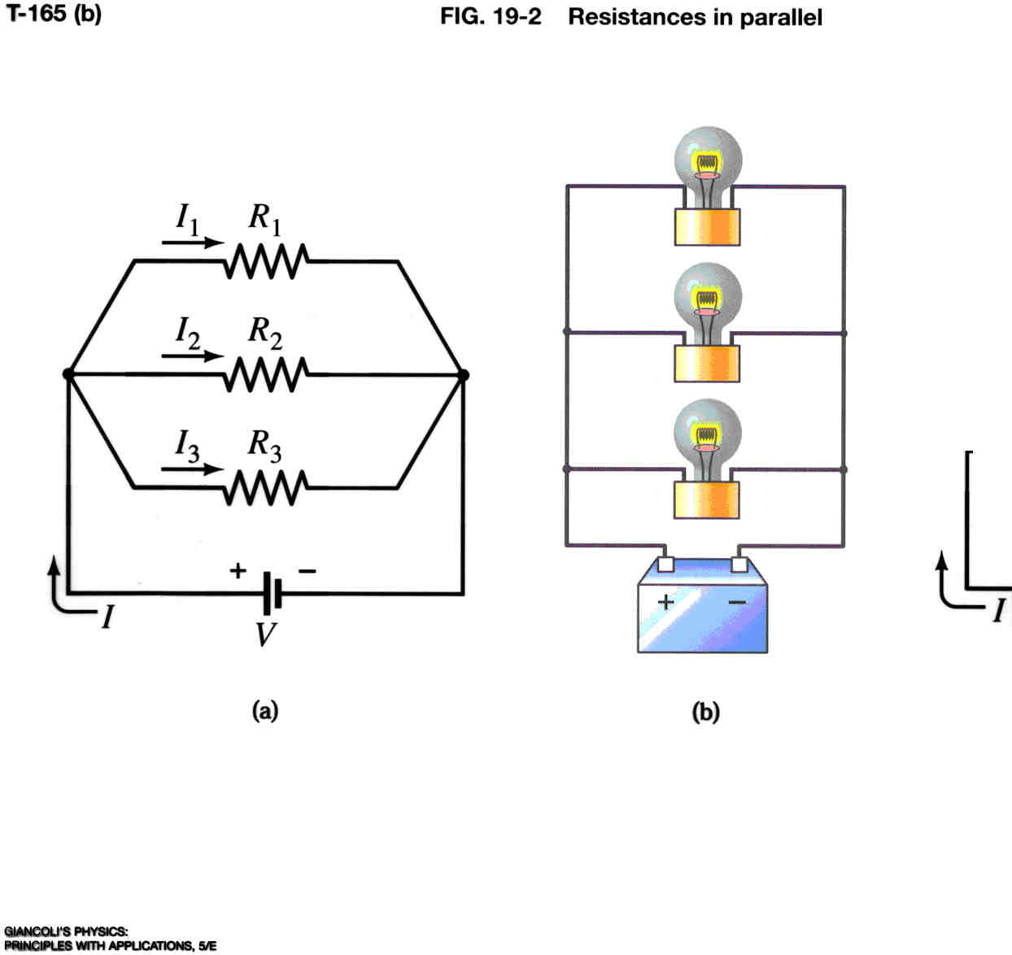
Resistors in parallel
Two devices are in parallel if they are connected at both ends
ΔV
ΔV
Same voltage drop across all devices ; current gets split up (then recombines).

Slide 5
White board example
Two i-clickers and more.
Series and parallel resistors. Two resistors (R₁ = 50 Ω; R₂ = 150 Ω ) are connected (a) in series and (b) in parallel to a 24 V battery (see Figure). What is the 1) equivalent resistance of each circuit; 2) what is the voltage drop across each resistor, 3) what current runs through each resistor and the entire circuit?
I₁
R₁
(b)
24 V
24 V
37.5 Ω
50 Ω
100 Ω
150 Ω
200 Ω
37.5 Ω
50 Ω
100 Ω
150 Ω
200 Ω

Slide 6
White board example
Series with parallel in circuit.
How much current, I, flows from the battery shown in the figure? Assume R₁ = 500 Ω, R₂ = 700 Ω.
How much current, I₁, flows through R₁?
How much power does R₁ consume?
292 Ω
The current I flows out of the battery.
Passes through 400-Ω resistor.
Splits into I₁ and I₂ and passes through the 500 Ω and 700 Ω resistor. Lower R gets higher I.
I₁ and I₂ combine, I runs back to battery.
Charge carriers leave battery with 12 V, loose 6.94 V at the 400 Ω resistor, loose 5.06 V at the parallel resistors, arrive with 0 V at battery, get lifted up to 12 V and start again.
692 Ω

Slide 7
Consider loop at right:
(start at point a (or point e))
I = 0.0174 A
V_{a→b} = - IR₁ = - 6.94 V
V_{b→c} = - IR₂ = - 5.06 V
6.94 V
V_{d→e} = + 12.0 V
5.06 V
Sum of all voltages:
- 6.94 V - 5.06 V + 12V = 0

Slide 8
Two i-clickers.
The brightness of a light bulb is proportional to the square of the current running through bulb. (Power consumed is P = RI²).
The circuit has three identical light bulbs each with resistance R.
When the switch is closed how will the brightness of bulbs A and B compare with C?
What happens when the switch is opened?
A
C
S
All the same
B is brighter than C
C is brighter than A and B
B and C are the same brightness
A and B are brighter than C
B

Slide 9
Electromotive Force (EMF) and Terminal Voltage
A device such as a battery or a generator that transforms one type of energy (chemical, mechanical) into electric energy is called a seat or source of electromotive force or emf.
The potential difference between the terminals of such a device, when no current flows to an external force, is called the emf of the source.
Symbol is .
Each battery itself has a resistance that is called internal resistance; it is designated r.
When no current is drawn from the battery the voltage between the terminals equals the emf.
If current is drawn from the battery, there is an internal voltage drop equal to Ir. Thus, the terminal voltage (voltage delivered) is
ΔV_{out} = ε - Ir
=
r
= 6 V

Slide 10
Ideal vs. Non-Ideal Batteries
Up until now, we’ve treated a battery as if it produced a fixed voltage, no matter what we demand of it.
Real batteries also have internal resistance, r. It limits the current and, therefore, the power that can be delivered.
If the internal resistance, r, is small compared to other resistances in the circuit, we can ignore it.
The maximum potential difference E across the battery is called electromotive force (emf).
The voltage output is ΔV_{out} = ε - Ir
i-clicker
A 30 V battery with internal resistance, r = 10 Ω, is connected to a resistor R (load) of 50 Ω. What is the actual voltage ΔV across the 50 Ω resistor (the actual output voltage of the battery)?
30 V
36 V
6 V
25 V
24 V
10 Ω
30 V
–
+
R_{load} = 50 Ω
Note, that ‘large load’ means a large current, and, thus a small R_{load} (many devices connected in parallel); Large load: R_{load} is smaller or on the order of r.
Notes:
Dashed lines are for the battery – like in Fig 28-1.

Slide 11
Kirchhoff’s Rules
Allow us to analyze complicated, multi-branched circuits, and come up with a set of equations for currents and voltages.
1. Rule (junction rule)
At any junction point, the sum of all currents entering the junction must be equal to the sum of all currents leaving the junction (Conservation of charge).
How to apply it:
First, assign a current and a direction to every pathway
Components in series will always have the same current
At every junction, write the equation:
12 V
I₁
–
+
3 Ω
I₂
+
–
B
A
5 Ω
6 V
i-clicker.
Which equation do you get for point A?
A) I₁ + I₂ = I₃ B) I₂ + I₃ = I₁
C) I₁ + I₃ = I₂ D) I₁ + I₂ + I₃ = 0
4 Ω
I₃

Slide 12
Kirchhoff’s Rules
2. Rule (loop rule)
The sum of the potential changes around any closed path of a circuit must be zero. (Conservation of energy).
12 V
I₁
–
+
How to apply it:
First, assign a direction to every loop
I often pick clockwise
Start anywhere, and set 0 equal to sum of potential changes from each element:
For batteries: ΔV = e
It is an increase if you go from – to +
It is a decrease if you go from + to –
For resistors: ΔV = IR
It is a decrease if you go with the current
It is an increase if you go against the current
3 Ω
I₂
+
–
5 Ω
6 V
4 Ω
I₃
Example:
Set up the equations for loop 1 and loop 2. What are currents I₁, I₂, I₃?

Slide 13
When applying Kirchhoff’s rules:
Label + and - for each battery. The long side of a battery symbol is +.
Label the current in each branch in the circuit with a symbol and an arrow (direction). The direction of the arrow can be chosen arbitrarily. If the current is actually in the opposite direction, it will come out with a minus sign in the solution.
Apply Kirchhoff’s junction rule at each junction, the loop rule at one or more loops. (Need as many equations as there are unknowns; possibly need more equations since some may be redundant.)
When applying the loop rule, follow each loop in one direction only (either clockwise or counterclockwise). Pay attention to signs:
For a resistor, the sign of the potential difference is negative if your chosen loop direction is the same as the chosen current direction through that resistor; the sign is positive if you are moving opposite to the chosen current direction.
For a battery, the sign of the potential difference is positive if your loop direction moves from the negative terminal toward the positive terminal; the sign will be negative if you are moving from the positive terminal toward the negative terminal.
Solve the equations for the unknowns. Be careful not to err with signs. At the end check your answers by plugging them into the original equations. We will use Maple, or other programs to solve equation sets.

Slide 14
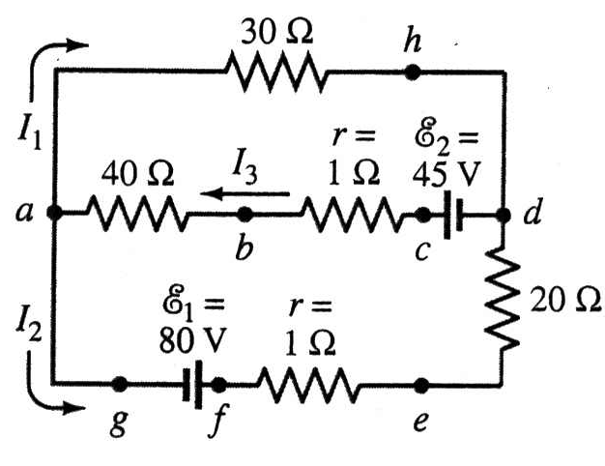
White board example: Solving problems with Kirchhoff’s rules:
Using Kirchhoff’s rules.
Calculate the currents I₁, I₂, I₃ in each of the branches of the circuit in the Figure.
We have three unknowns
--> We need three equations.
-
+
-
+
Use Maple, a powerful Math program to solve equation set for us:
solve({I3 = I1+I2, -30*I1+45-41*I3 = 0, 41*I3+21*I2-125 = 0}, {I1, I2, I3});
$$\{I1=−\frac{2335}{2721}, I2=\frac{7030}{2721}, I3=\frac{1565}{907}\}$$

Slide 15
Circuits containing a resistor and a capacitor (RC circuits)
(Still DC → current in one direction, but changes over time (decreases, increases).
Discharging a capacitor:
Time constant: RC (units: second)
Large RC: slow discharging
In a time t = τ = RC seconds charge (also voltage and current) fall to 37% (1/e = 0.37)

Slide 16
Circuits containing a resistor and a capacitor (RC circuits)
(Still DC → current in one direction, but changes over time (decreases, increases).
Charging a capacitor:
Time constant: RC (units: second)
Large RC: slow discharging
In a time t = τ = RC seconds voltage increases to 63% (100% – 37%) of final voltage

Slide 17
White board example
An RC circuit.
If a capacitor with capacitance, C = 35 μF, is connected to a resistor with resistance, R = 120 Ω, how much time will elapse until the voltage falls to 50 percent of its original (maximum) value (half life)?

Slide 18
Electric shock
The severity of an electric shock depends on the magnitude of the current, how long it acts and through what part of the body it passes.
Can feel ~ 1 mA; pain at a few mA; severe contractions above 10 mA; heart muscle irregularities above 70 mA.
Current above 100 mA for only a few seconds can be fatal.
Resistance of dry skin ~ 10⁴ to 10⁶ Ω; wet skin 10³ Ω or less.
A person in good contact with ground who touches a 120 V line with wet hands can suffer a current

Slide 19
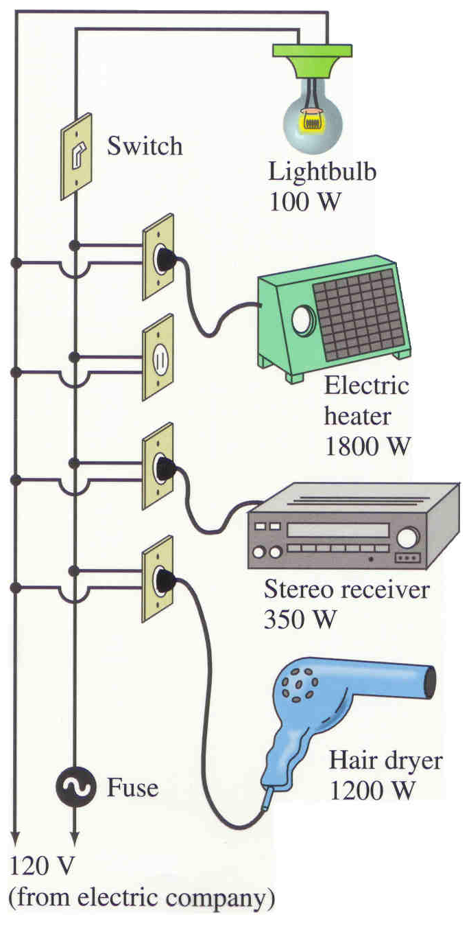
Power in Household circuits
(All appliances are connected in parallel)
Fuses:
Electrical wires in a household can get too hot, if they are not thick enough for the amount of current running through them.
This is a fire hazard.
To avoid this danger, circuit breakers (fuses) are installed, which break the circuit if the current running through a wire is too high (e. g. above 20 A).
Wires of varying thickness are connected to different circuit breakers (thick wires are needed to carry high currents).
Resistance of a wire

Slide 20
White board example
Will the fuse blow?
Determine the total current drawn by the devices in the circuit shown in the Figure.
Light bulb: 0.8 A
Heater: 15.0 A
Stereo: 2.9 A
hair dryer: 10.0 A
Total: 28.7 A
A 20 A fuse would blow

Slide 21
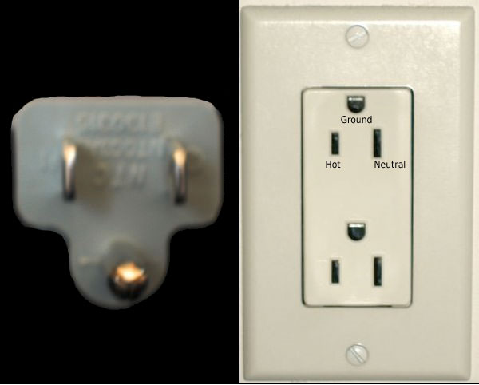
Electrical safety, two-pronged, three-pronged plugs
Two pronged plug: One is ‘hot’ or ‘live’; the other carries current to ground.
If the “hot” wire touches the metal casing of an appliance, it becomes “hot” and simply touching the metal case can result in shock.
Three pronged plug: One wire is ‘hot’ or ‘live’ (narrower slit); the other carries current to ground (wider slit).
Grounding the metal case through the third wire (round prong)
→ metal case is always grounded and no shock can occur.

Slide 22
Review
Resistors in series
Resistors in parallel
Know how to apply these rules to complex circuits
Electromotive power and internal resistance
Kirchhoff’s rules (Know how to apply to a circuit):
1. Rule (junction rule)
At any junction point, the sum of all currents entering the junction must be equal the sum of all currents leaving the junction. (Conservation of charge).
2. Rule (loop rule)
The sum of the changes in potential around any closed path of a circuit must be zero. (Conservation of energy).
RC circuits, time constant τ = RC
House hold wiring (circuits with appliances in parallel and a circuit breaker in series; electrical safety.

Slide 23
Extra Slides

Slide 24
Extra White board example (for practice)
Analyzing a circuit. A 9.0-V battery whose internal resistance r is 0.5 Ω is connected in the circuit as shown in the figure.
How much current is drawn from the battery? (I = 0.88 A)
What is the terminal voltage (output voltage) of the battery? (8.56 V)
What is the current in the 6.0-Ω resistor? (I = 0.48 A)

Slide 25
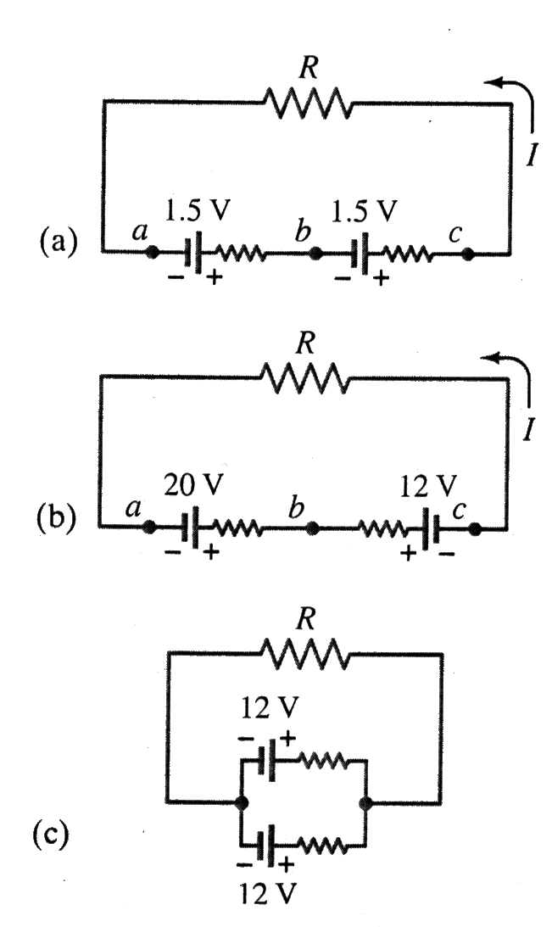
EMFs in series and in parallel
Connecting the emfs in series head-to-tail, the voltages add up. V_{total} = V₁ + V₂.
(b) Connecting the emfs in series tail-to-tail or head-to-head, the voltages subtract V_{total} = V₁ - V₂. Can be used for re-charging batteries.
(c) Connecting emfs in parallel. Used to provide energy when large amounts of current are needed (starting Diesel engines).

